Slide 1

Presented by
B. Uma sankari,
3rd year computer science and engineering,
Universal college of engineering and technology.

Slide 2

Keyloggers define
A keylogger or keystroke logger/keyboard capturing is a form of malware or hardware that keeps track of and records your keystrokes as you type. It takes the information and sends it to a hacker using a command-and-control (C&C) server.

Slide 3
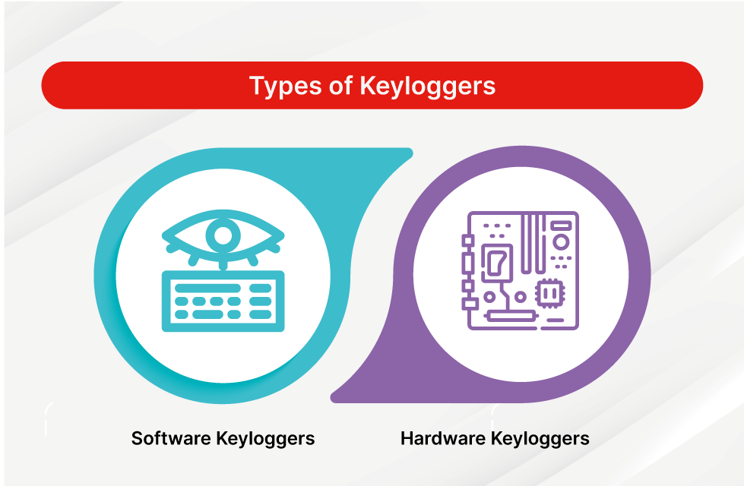
Types of keyloggers
There are two types of keyloggers: hardware keyloggers and software keyloggers.
The two types of keyloggers differ by the way that they log a keystroke.
Both types of keyloggers can be used for malicious purposes, including credential theft and identity theft.

Slide 4
Keyloggers with example
software keylogger is put on a computer when the user downloads an infected application.
Once installed, the keylogger monitors the keystrokes on the operating system you are using, checking the paths each keystroke goes through.
In this way, a software keylogger can keep track of your keystrokes and record each one.

Slide 5
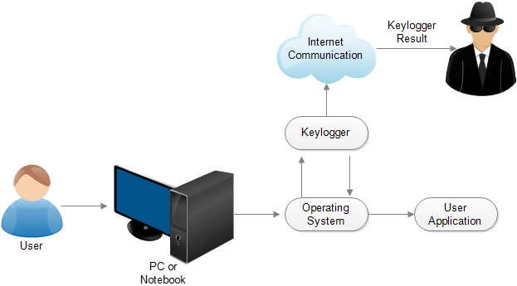
Diagram with keyloggers

Slide 6
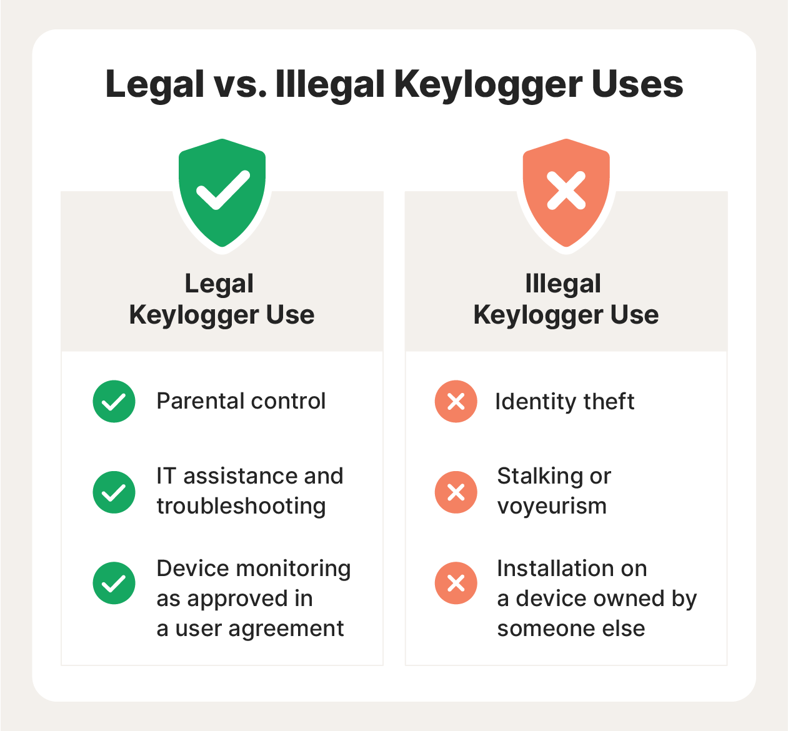
Illegal and legal
A common example of a hardware-based keylogger is the keyboard overlay that a hacker uses in an ATM skimming attack.
Every time a bank customer presses the buttons on the criminal's fake keypad — thinking it's a legitimate ATM keypad — the keylogger records the keystrokes and sends the information to the cybercriminal.

Slide 7
features of keylogger
They can capture virtually every type of information entered through a keyboard; this includes but is not limited to email correspondence, instant messages, documents, and web forms. Software keyloggers, the more prevalent type, work by functioning at the kernel level of an Operating System (OS).

Slide 8
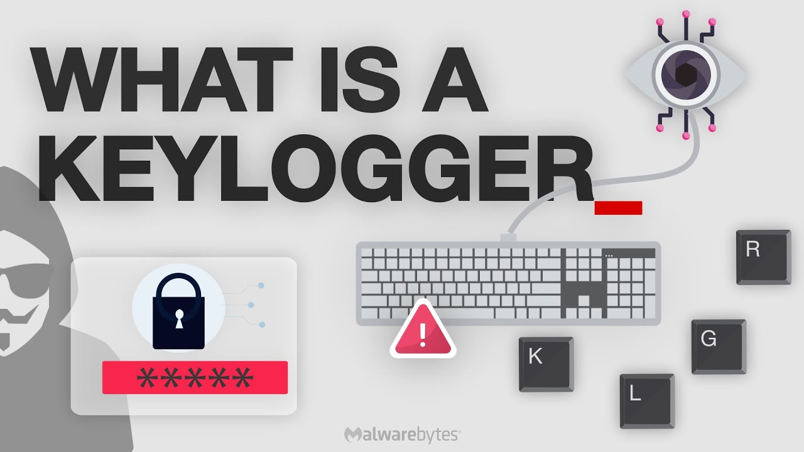
keylogger in phishing
Keylogger is a piece of spyware that secretly records what you type on your computer. Read more about keyloggers and how to protect yourself.

Slide 9
Thank you

